Slide 1




WELCOME
ANCHORS AND JUNIORS

Slide 2
GOD IS
OUR ANCHOR
SONG

Slide 3
Insert ‘GOD IS OUR ANCHOR’
LYRIC/ACTION VIDEO HERE

Slide 4
MEMORY
VERSE

Slide 5


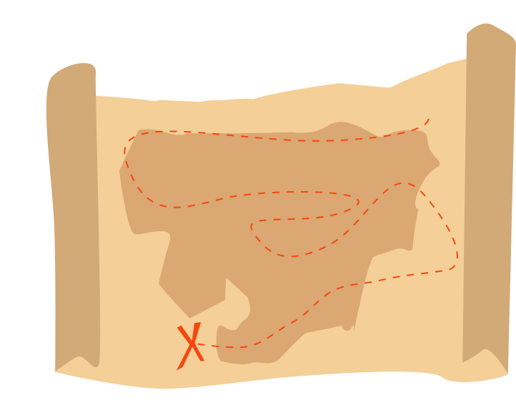




The bible says in Psalm chapter 147 verse 11
“God delights in those
who put their hope in His unfailing love.”

Slide 6
The bible says in Psalm chapter 147 verse 11
“God delights in those
who put their hope in His unfailing love.”

Slide 7
Insert ‘follow up ONE’
VIDEO HERE

Slide 8
Discussion questions
What do you put your hope in to make you happy?
How do you feel when the things you put your hope in don’t work out?

Slide 9
Discussion questions
Why do we describe god as our anchor?
Do you believe that god is your greatest hope?
Have you put your hope and trust in him?

