Slide 1






ENROLMENT SLIDE PACK
In this slide pack:
Slide that can be used as part of the church announcements in the weeks leading up to enrolment. Time and date of service can be added. Companies can replace the logo with the customised logo provided by BBNI.
General slides about BBNI.
Companies can replace pictures with pictures from their own BB.
Welcome slide which can be used at the enrolment service.

Slide 2


PLEASE JOIN US AT OUR BOYS’ BRIGADE ENROLMENT SERVICE
Insert date
Insert time
Everyone welcome

Slide 3


Slide 4
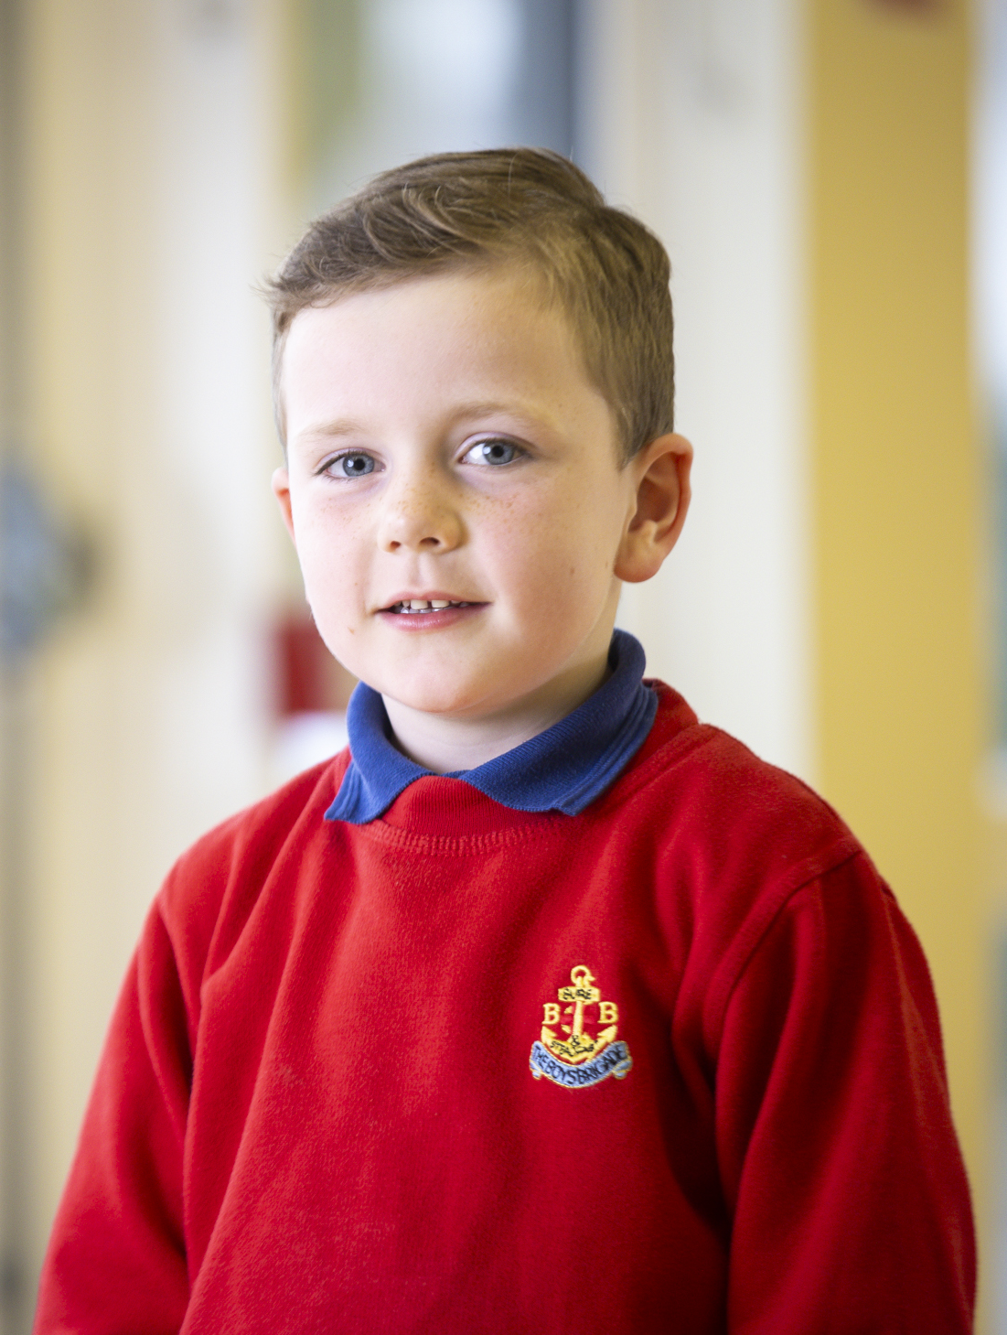
OUR OBJECT:
The advancement of Christ's Kingdom among Boys and the promotion of habits of obedience, reverence, discipline,
self-respect and all that tends towards a true Christian manliness.

Slide 5
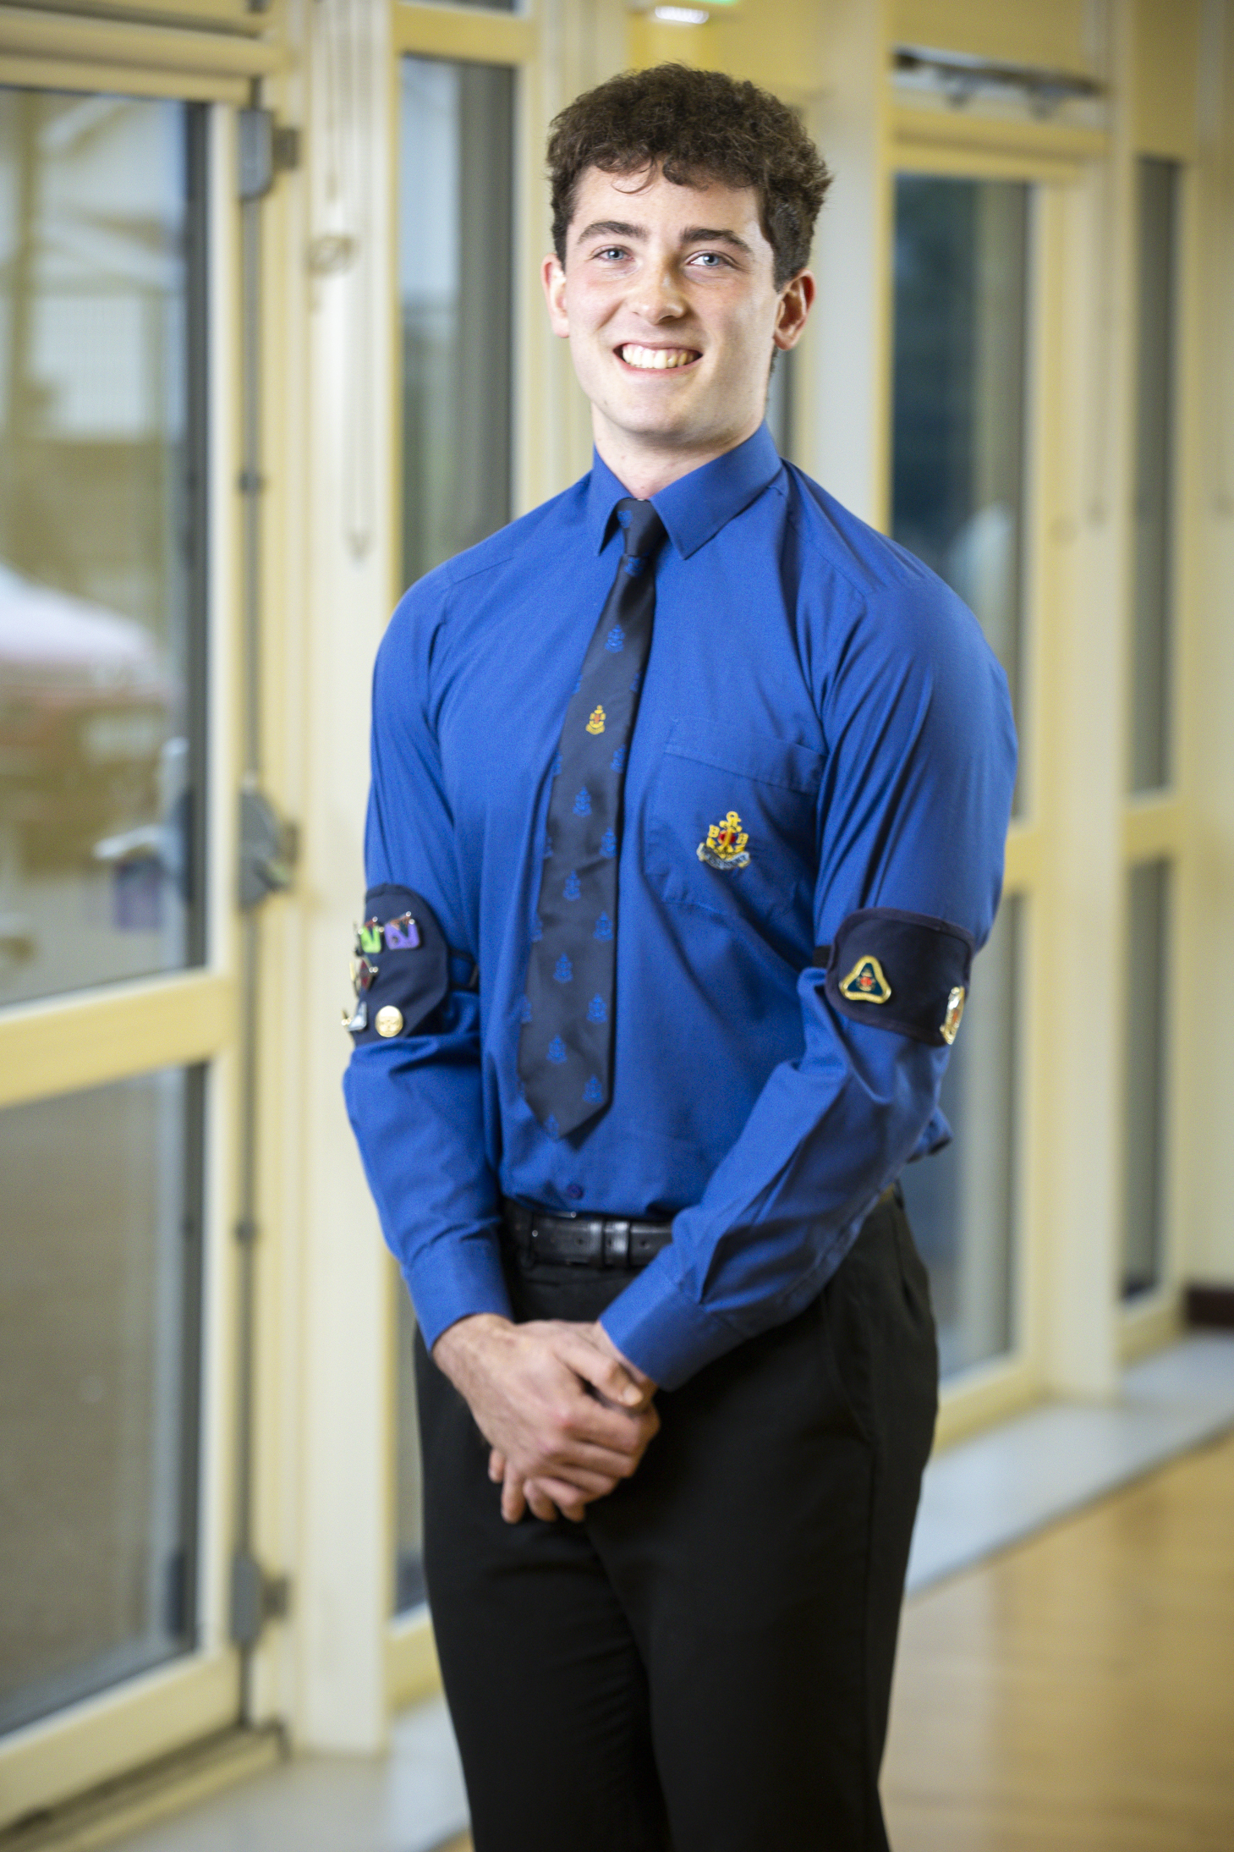
We have this HOPE as an ANCHOR for the soul, a HOPE both SURE and STEADFAST.
Hebrews 6:19

Slide 6

THE NORTHERN IRELAND BOYS’ BRIGADE (BBNI)
Over
11,300
Boys &
Young Men
Over
2,400
Volunteer
Leaders
244
Companies
(NI & Donegal)

Slide 7
THE NORTHERN IRELAND BOYS’ BRIGADE (BBNI)
Over
11,300
Children &
Young People
Over
2,400
Volunteer
Leaders
244
Companies
(NI & Donegal)

